Slide 1




Amin Nadimy
Applied Modelling and Computational Group, Department of Earth Science and Engineering
Supervisors:
Professor C. C. Pain, Dr P. Salinas, Dr A. I. Obeysekara and Dr A. Nicolle (BP)
ICL-ICAM-BP
24th March 2021

Slide 2


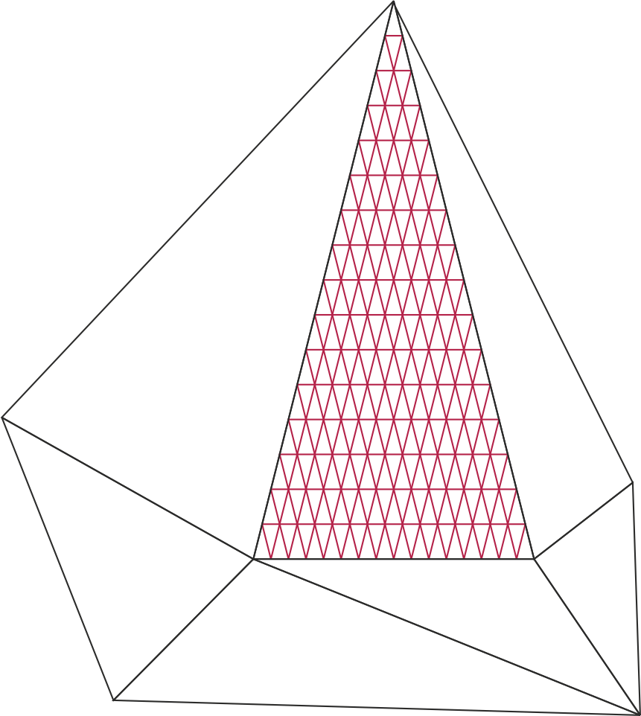
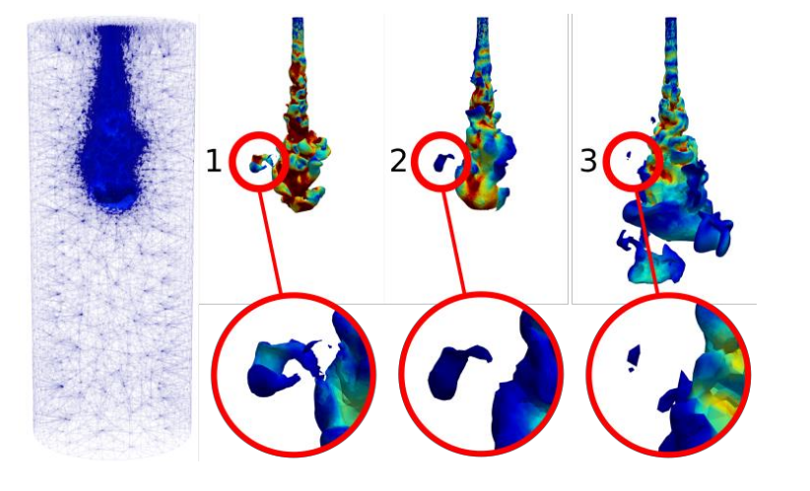
Dynamic semi-structured meshes for fast numerical simulation of Multi-Phase Modelling in the energy industry
Starting date: 01 October 2020
Aim:
This project will develop and implement a semi-structured mesh within the Multi-Fluidity project to significantly improve its speed.
Figure 1. Semi-structured mesh.
Figure 2. Creation and dispersion of a droplet.
ICL-ICAM-BP
24th March 2021

Slide 3
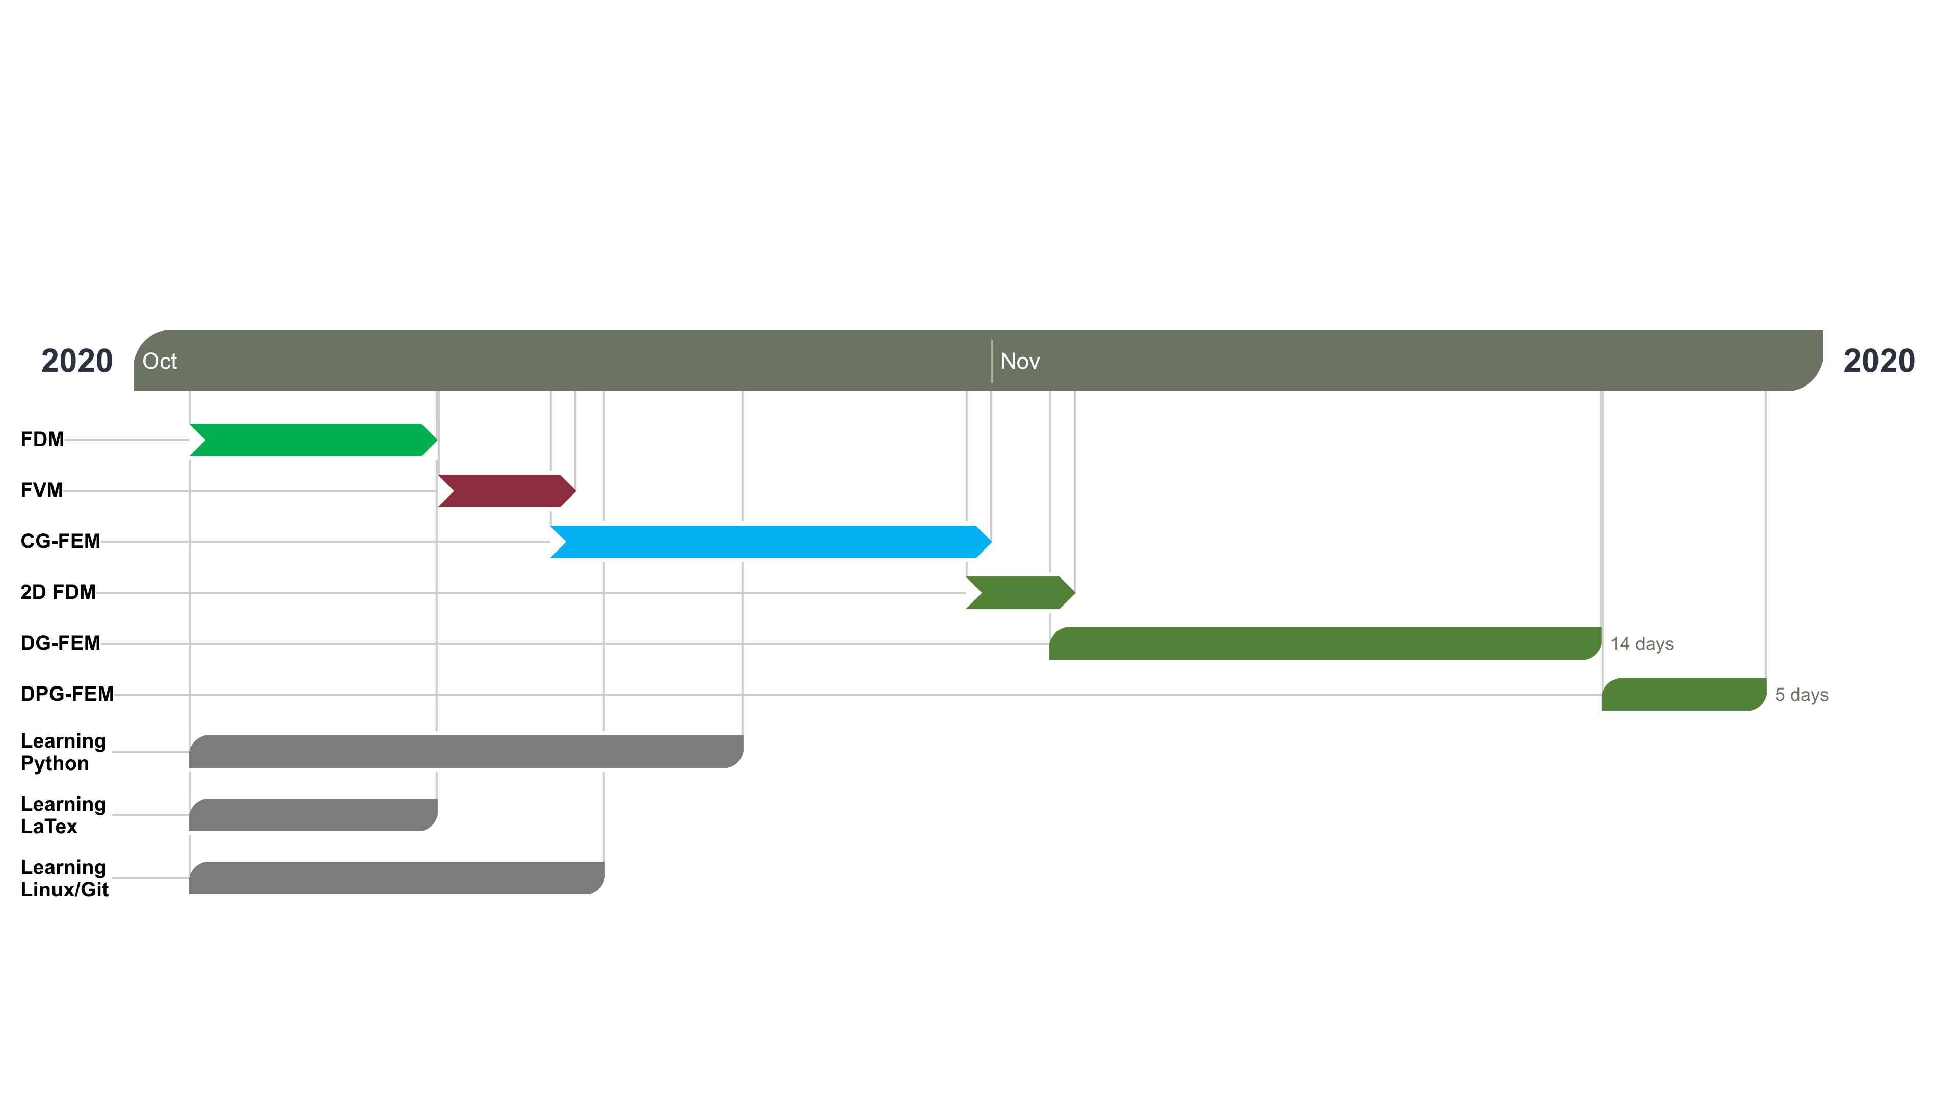
Starting date: 01 October 2020
Figure 3. Work plan from October to mid-December 2020.
ICL-ICAM-BP
24th March 2021

Slide 4
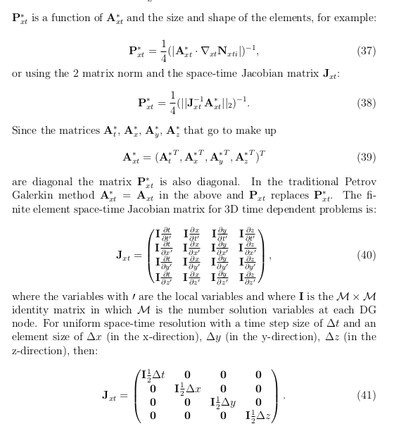
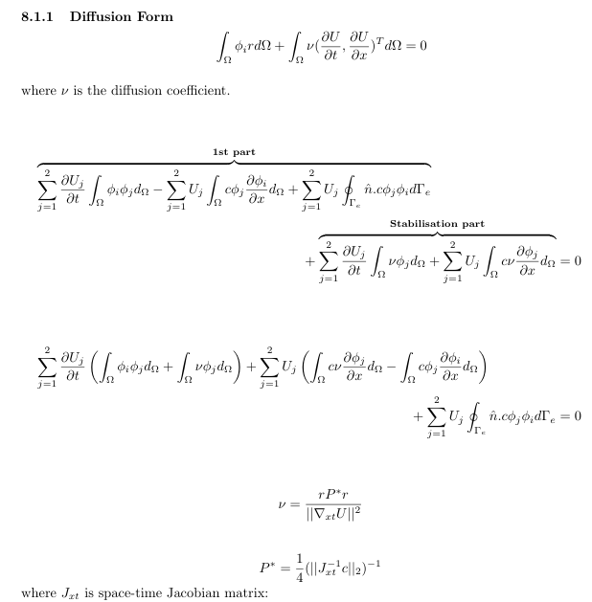

- 1D-DG Petrov-Galerkin FEM: 2 documents
1- Report
1- Theory
ICL-ICAM-BP
24th March 2021

Slide 5
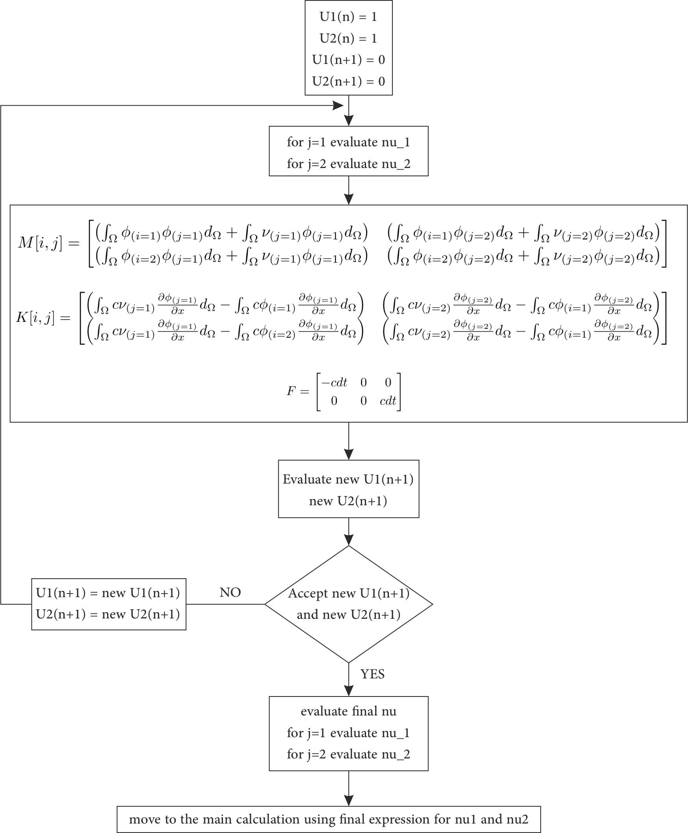
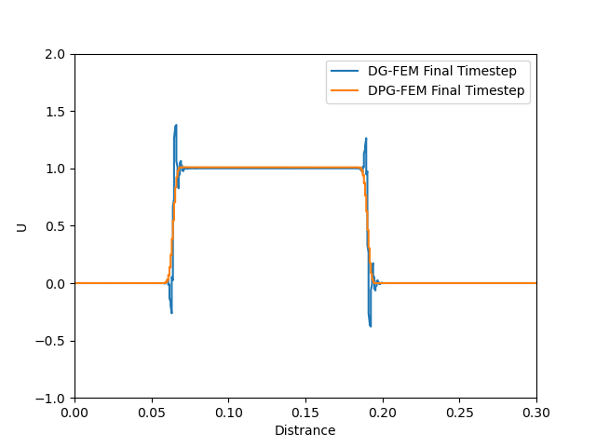
Figure 5. Illustration of the standard DG against DPG results for the same number of elements, 400.
Figure 4. Flowchart for the DG Petrov-Galerkin diffusion method.
ICL-ICAM-BP
24th March 2021

Slide 6
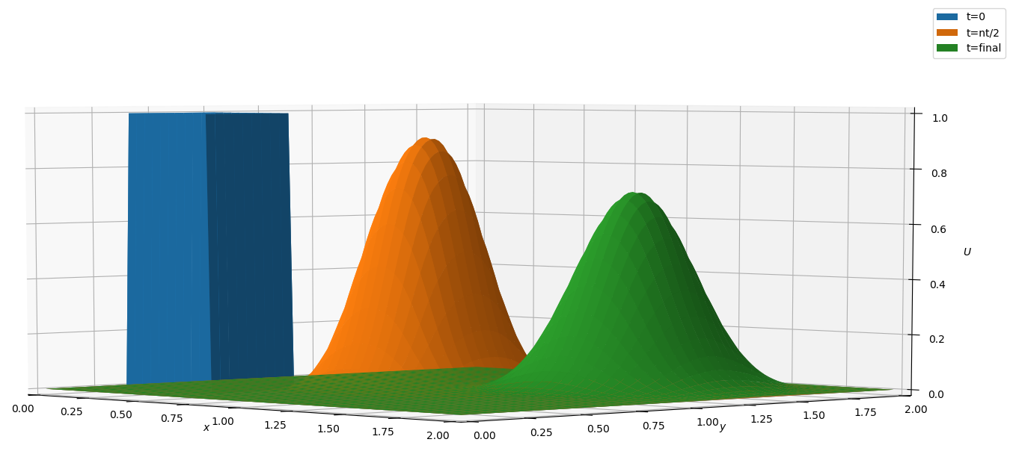
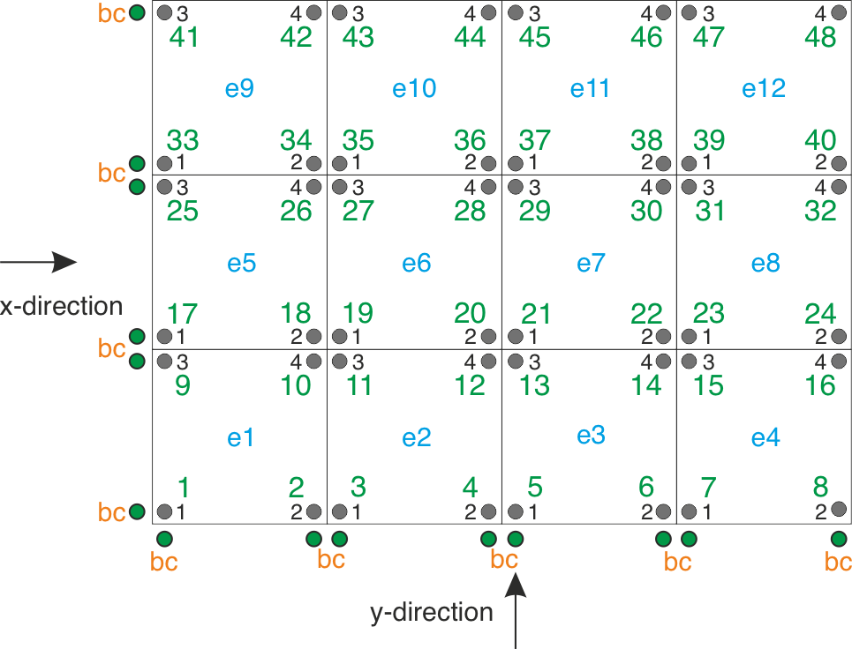
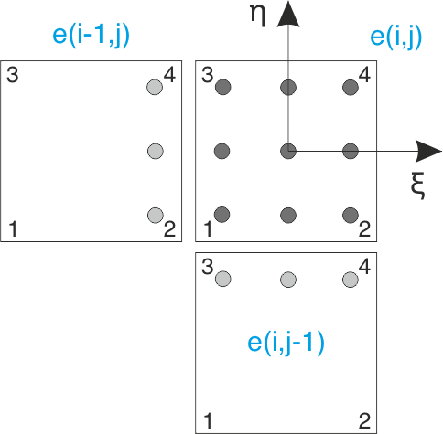
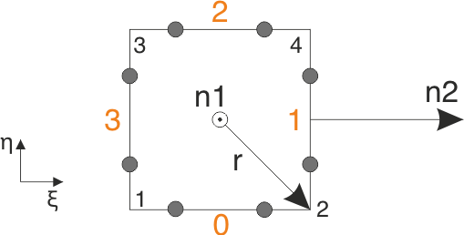
- 2D FDM
- 2D DG-FEM
Figure 6. Travelling a square wave in 2D with 500 elements.
Figure 9. Surface integration using 2-point Gaussian quadrature method.
Figure 8. Volume integration using 3-point Gaussian quadrature method.
Figure 7. 2D domain with local & global node numbering.
ICL-ICAM-BP
24th March 2021

Slide 7
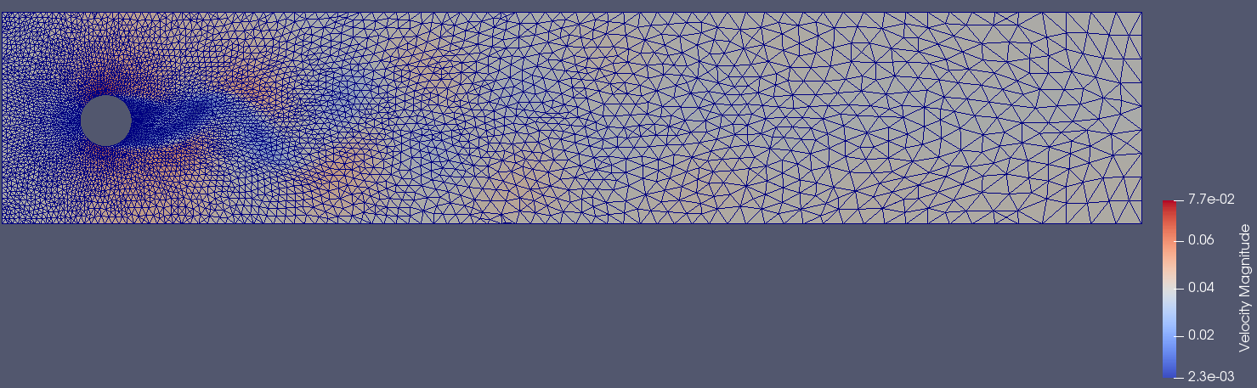
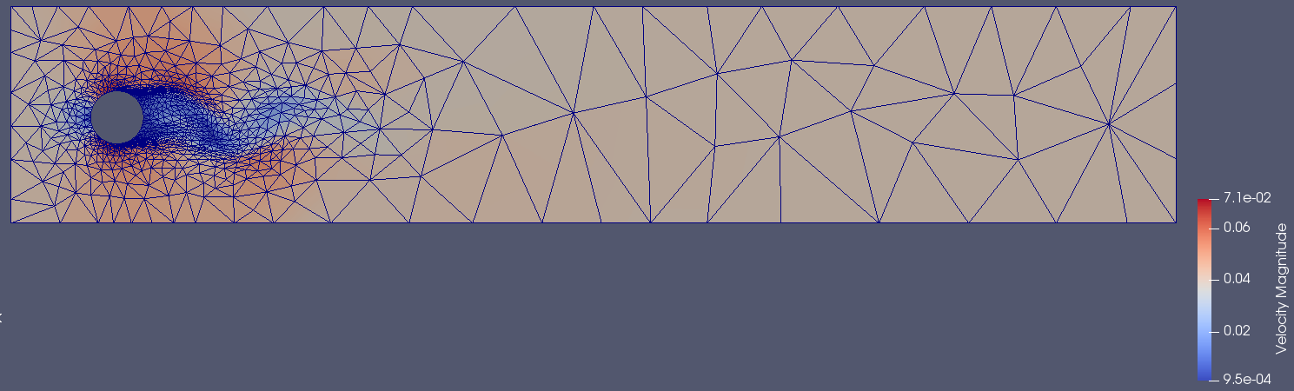
- Fortran Training - IC-FERST Workshop
Training sessions: multi-phase time-loop in the IC-FERST, identified the key subroutines corresponding to momentum, magma, porous media equations and their variables.
Training for connecting & working with workstations, downloading and compiling IC-FERST code.
2D test files e.g. flow pass in a cylinder & collapsing water column. changed the flow velocity, the shapes and the positions of the problem.
Figure 10. Flow pass a cylinder with the fixed mesh.
Figure 11. Flow pass a cylinder with the adaptive mesh.
Simulation info:
Number of elements: 9444
Final time: 100
Time-step: 0.005
Reynolds number: 3900
Simulation info:
Initial number of elements: 168
Final number of elements: 2032
Final time: 100
Time-step: 0.005
Reynolds number: 3900
ICL-ICAM-BP
24th March 2021

Slide 8
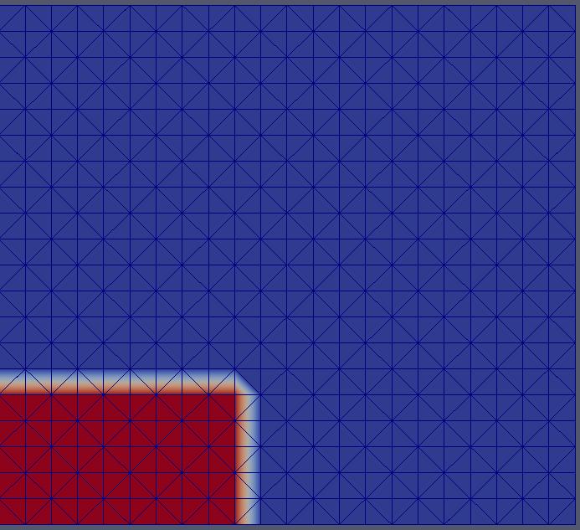
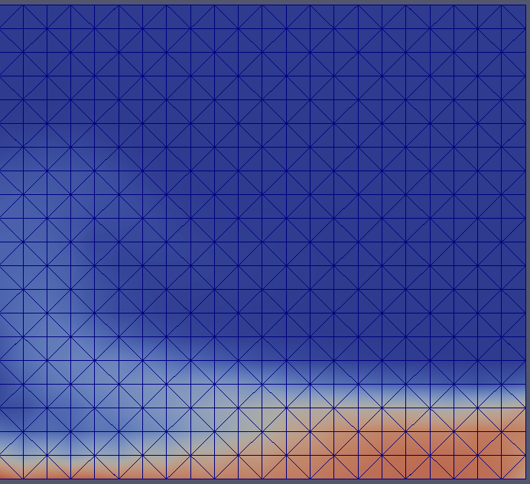
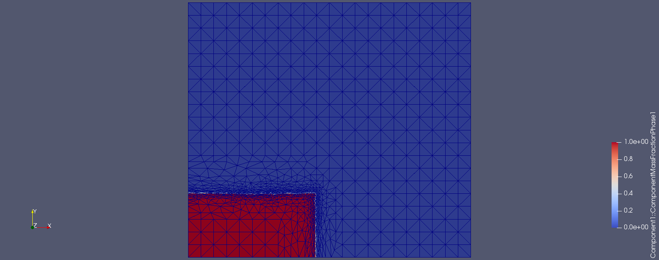
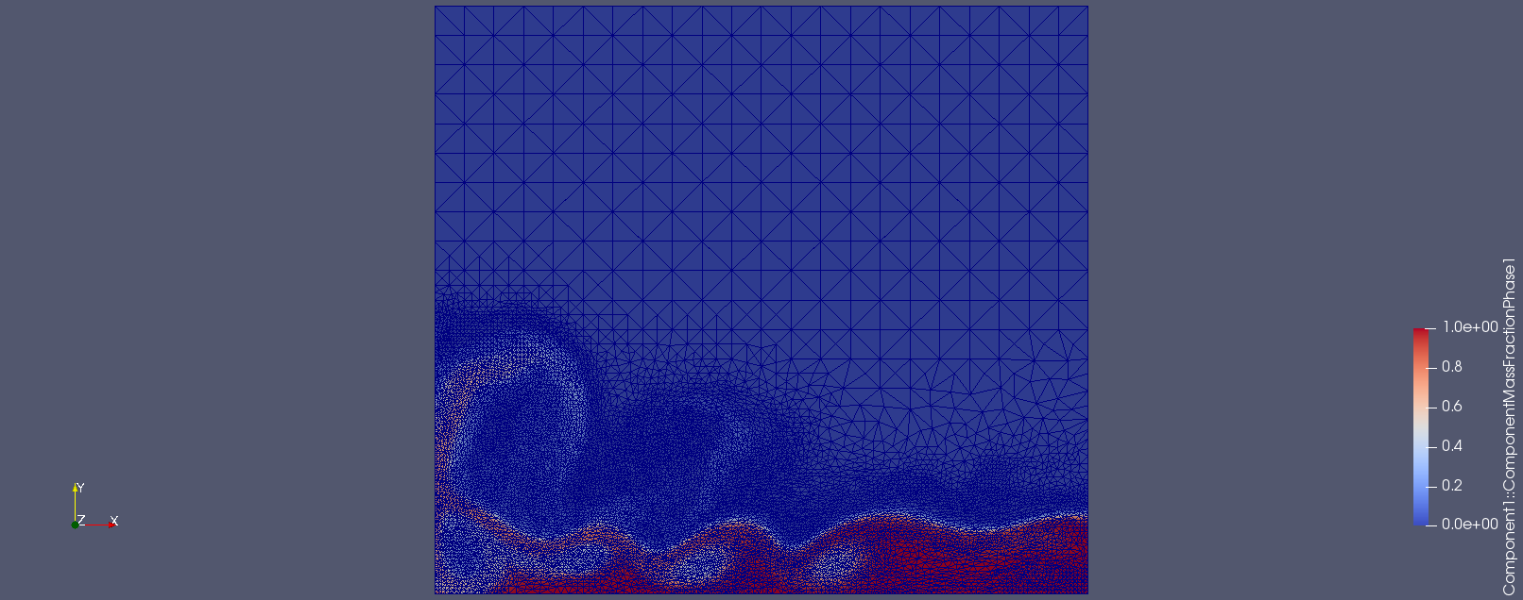
- Fortran Training - IC-FERST training
Training sessions: multi-phase time-loop in the IC-FERST, identified the key subroutines corresponding to momentum, magma, porous media equations and their variables.
Training for connecting & working with workstations, downloading and compiling IC-FERST code.
2D test files e.g. flow pass in a cylinder & collapsing water column. changed the flow velocity, the shapes and the positions of the problem.
Figure 12. Collapsing water column under gravity with a fixed mesh.
Figure 13. Collapsing water column under gravity with the adaptive mesh.
ICL-ICAM-BP
24th March 2021

Slide 9
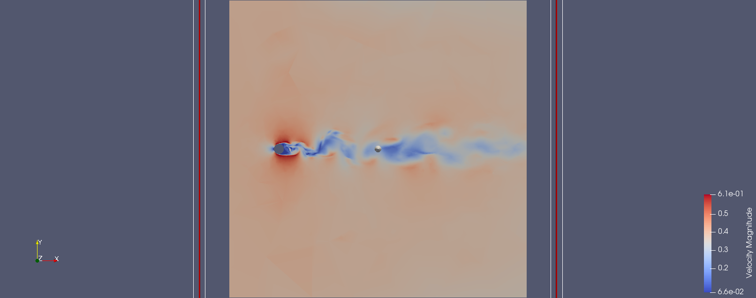
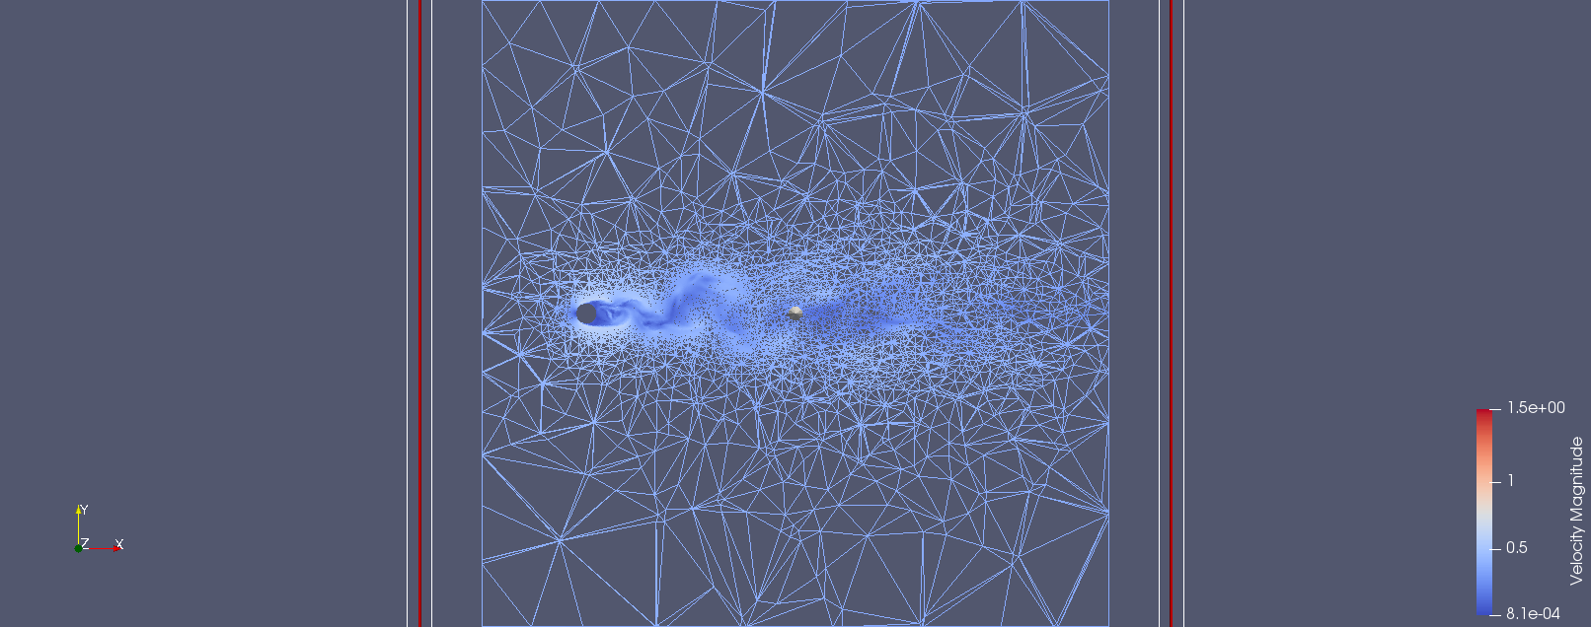
3D test files for flow pass in a cylinder case.
Simulation info:
Initial number of elements: 8470
Final number of elements: 21480
Final time: 0.76
Time-step: 0.005
Reynolds number: 3900
Figure 14.Flow pass in a cylinder in 3D with the adaptive mesh.
Figure 15.Sliced mesh view for the flow pass in a cylinder problem in 3D with the adaptive mesh.
ICL-ICAM-BP
24th March 2021

Slide 10
Regular weekly meetings
AMCG catch-up
Porous media/Inertia
BP catch-up
Theory
Delaunay and barycenter triangulation (a few days)
Voronoi diagram
Structured mesh generation
Unstructured mesh generation (~a month)
Semi-structured mesh
Near-future work
Will be working with Dr. Obeysekara on the mixing tank problem (end of March)
2D 1st order square wave DG-FEM (end of March)
semi-structured 2D DG-FEM.
Will be work with Prof. Pain and others on the Fortran code for semi-structured and with space-time within ICFERST/FLUIDITY.
ICL-ICAM-BP
24th March 2021

Slide 11
END
ICL-ICAM-BP
24th March 2021

